Slide 1
Emotional Distress in Patients with Chronic Lymphocytic Leukemia Compared to the General Population
Alec Trifilo
Dr. Marcus Herman-Giddens
Justin Seweryn

Slide 2
What is Chronic Lymphocytic Leukemia?
CLL is the most common adult leukemia
Bone marrow makes too many lymphocytes
Patient Population
Male
Caucasian
> 65

Slide 3
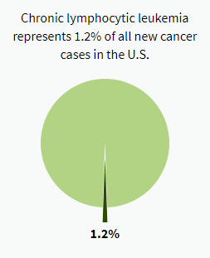
What is Chronic Lymphocytic Leukemia?
Demographics
Median diagnosis is 70 years
Median death is 81 years
Per 100,000 people:
7 male, 4 female
7 white, 2 black

Slide 4
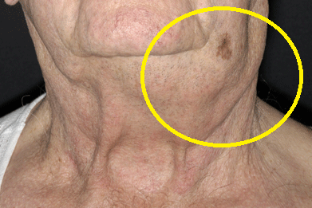
Physical Symptoms
Appear at third or fourth stage
More illnesses with worse effects
Enlarged lymph nodes
Fatigue
Excessive bleeding/bruising
Shortness of breath
Fever

Slide 5
Emotional Symptoms
Increased levels of:
Anxiety – related to not knowing disease progression
Depression – Probability of death
Stress - Treatments
Lower quality of life

Slide 6
Emotional symptoms
Cancer survivors are more than twice as likely to have disabling psychological problems compared with adults without cancer.
Individuals who have both cancer and other chronic illnesses have 6 times higher risk of mental illness than adults without cancer.

Slide 7
Hypothesis
The presence and severity of psychological conditions is increased in individuals with CLL as compared to those without physical illnesses.

Slide 8
Methodology
Experimental Group: CLL patients
Control Group: Non-ill individuals
Patient demographics:
Over 50
Live in the USA
Includes men and women
All races ( majority Caucasian )

Slide 9
Methodology
Surveys used:
K10 - Overall Psychological stress
PHQ-9 - Depression
GAD-7 - Anxiety
PSS – Stress
Each survey highlights a different emotional symptom of CLL, providing a comprehensive assessment of mental health

Slide 10
Methodology
K10
PHQ-9
GAD-7
PSS

Slide 11
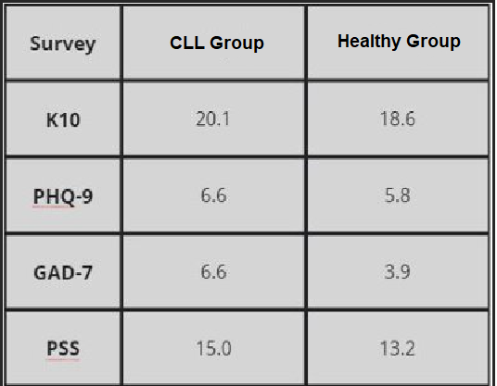
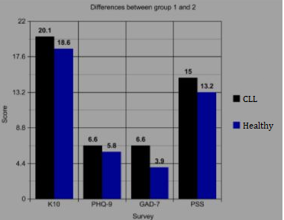
Results

Slide 12
Discussion
K10- Measure of Overall psychological distress
CLL Group – mild-severe
Healthy Group – none-mild
PHQ-9- Measure of Depression
CLL Group – mild-moderate
Healthy Group – minimal-moderate
GAD-7 – Measure of Anxiety
CLL Group – mild-moderate
Healthy Group – low - mild
PSS – Measure of Stress
CLL Group – moderate
Healthy Group - low

Slide 13
Discussion
Analysis of mental status can:
Improve treatment through therapy
Improve quality of life
A clinically worse mental health status has been linked to longer hospital stays and higher chances of re-admission.

Slide 14
Discussion
Mental health treatment in conjunction with cancer treatment can help prevent readmissions.
Mental health screenings should be performed as it could provide patients with assistance as a way to prevent setbacks or relapses

Slide 15
Conclusion
Patients with chronic lymphocytic leukemia have higher levels of depression, anxiety, stress, and a lower quality of life.

Slide 16
Future work
How can mental health treatment be used in conjuction with chemotherapy or radiation?
Positive benefits
Better outcomes
Longer survival

Slide 17
Works Cited
Chronic Lymphocytic Leukemia - Cancer Stat Facts. (n.d.). Retrieved from https://seer.cancer.gov/statfacts/html/clyl.html
Naughton, M. J., & Weaver, K. E. (2014). Physical and mental health among cancer survivors: considerations for long-term care and quality of life. North Carolina medical journal, 75(4), 283–286. https://doi.org/10.18043/ncm.75.4.283
Richardson, D., MD. (2016, December 5). Psychosocial Factors Associated With High Readmission Rates Longer Hospital Stays. Retrieved February 4, 2021, from https://cancer.osu.edu/news/psychosocial-factors-associated-with-high-readmission-rates-longer-hospital-stays
Turner, J., & Kelly, B. (2000). Emotional dimensions of chronic disease. The Western journal of medicine, 172(2), 124–128. https://doi.org/10.1136/ewjm.172.2.124
Zabora, J., Brintzenhofeszoc, K., Curbow, B., Hooker, C., & Piantadosi, S. (2001). The prevalence of psychological distress by cancer site. Psycho-Oncology, 10(1), 19–28. https://doi.org/10.1002/1099- 1611(200101/02)10:1<19::aidpon501>3.0.co;2-6
Lauber, C., Falcato, L., Nordt, C. and Rössler, W. (2003), Lay beliefs about causes of depression. Acta Psychiatrica Scandinavica, 108: 96-99. https://doi.org/10.1034/j.1600- 0447.108.s418.19.x
Shanafelt, T. D., Bowen, D., Venkat, C., Slager, S. L., Zent, C. S., Kay, N. E., Reinalda, M., Sloan, J. A., & Call, T. G. (2007). Quality of life in chronic lymphocytic leukemia: an international survey of 1482 patients. British journal of haematology, 139(2), 255–264. https://doi.org/10.1111/j.1365- 2141.2007.06791.x
Holzner, B., Kemmler, G., Kopp, M., Nguyen-Van-Tam, D., Sperner-Unterweger, B., & Greil, R. (2004). Quality of life of patients with chronic lymphocytic leukemia: results of a longitudinal investigation over 1 yr. European journal of haematology, 72(6), 381–389. https://doi.org/10.1111/j.1600- 0609.2004.00233.x
Ringdal, G. I., & Ringdal, K. (2019). Cancer and depression: A comparison of cancer victims with the general population, findings from the European Social Survey 2014. Scandinavian journal of public health, 47(5), 504–510. https://doi.org/10.1177/1403494817727161

Slide 18
Acknowledgements
Marcus Herman-Giddens, UNC Chapel Hill
Justin Seweryn
Richard Santo Trifilo
Laura and Bill Trifilo
Science Research Peers

